Slide 1









Whiteboardmaths.com
7
2
1
5
© 2008 All rights reserved

Slide 2
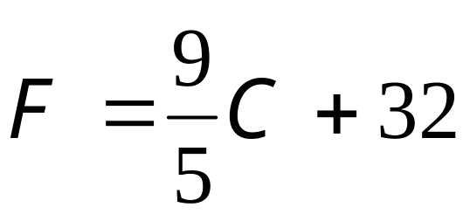
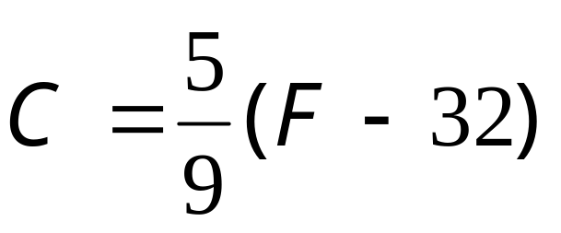
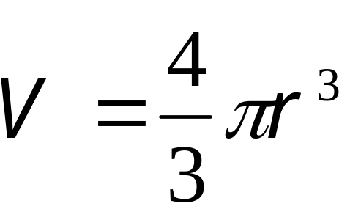
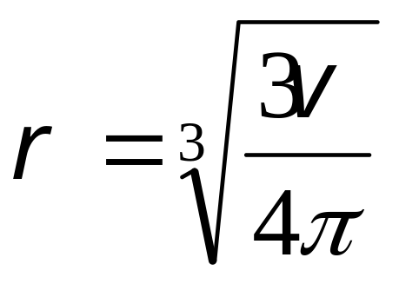
Intro
Transposition of Formulae (Change of Subject)
Sometimes it is necessary to rewrite a formula in order to find a new subject.
F the subject
C the subject
ºC
ºF
0
32
V the subject
r the subject
r

Slide 3
Examples 1
Transposition of Formulae (Change of Subject)
Sometimes it is necessary to rewrite a formula in order to find a new subject.
The operations involved in changing the subject of formulae are the same as those involved in solving equations.
Example Question 1: Make t the subject of the formula:
m = 6p + t
subtract 6p from both sides
m - 6p = t
Re-write with the new subject on the left as usual.
t = m - 6p
Example Question 2: Make y the subject of the formula:
Dy - 3e = 2g + 5
add 3e to both sides
Dy = 2g + 3e + 5
Divide both sides by D
2g + 3e + 5
y =
D

Slide 4
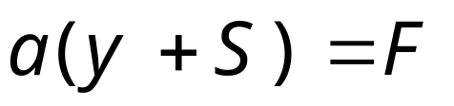
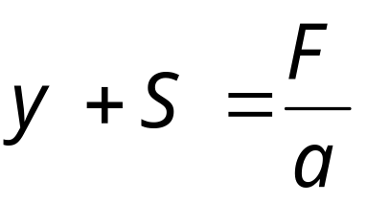
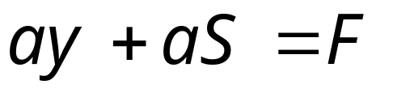
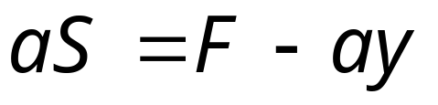
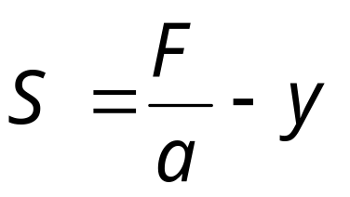
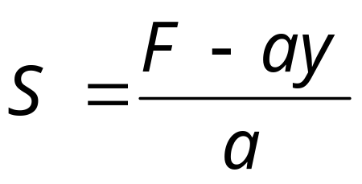
Transposition of Formulae (Change of Subject)
Sometimes it is necessary to rewrite a formula in order to find a new subject.
The operations involved in changing the subject of formulae are the same as those involved in solving equations.
Example Question 3: Make S the subject of the formula:
Example Question 3 (alternative) Make S the subject of the formula:
Expand brackets
Divide by a
Subtract ay
Subtract y
Divide by a
Equivalent

Slide 5
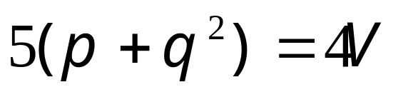
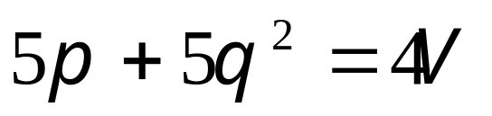
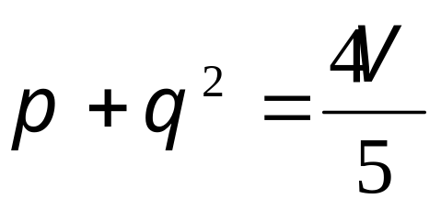
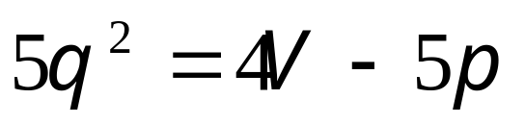
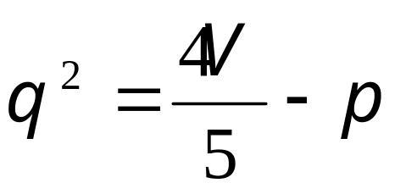
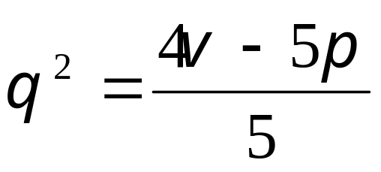
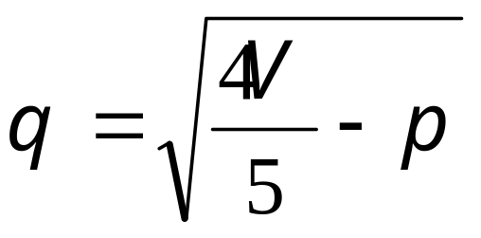
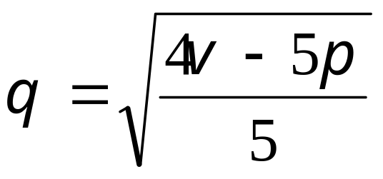
Transposition of Formulae (Change of Subject)
Sometimes it is necessary to rewrite a formula in order to find a new subject.
The operations involved in changing the subject of formulae are the same as those involved in solving equations.
Example Question 4: Make q the subject of the formula:
Example Question 4 (alterative) Make q the subject of the formula:
Expand brackets
Divide by 5
Subtract 5p
Subtract p
Divide by 5
√ both sides
√ both sides
Equivalent

Slide 6
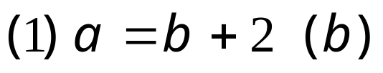

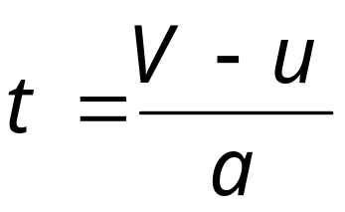

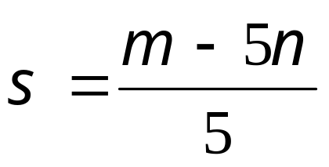
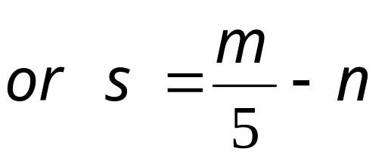

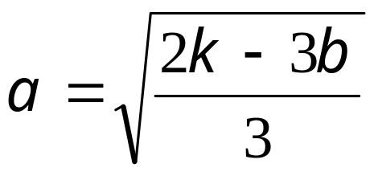
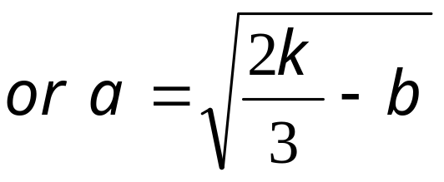
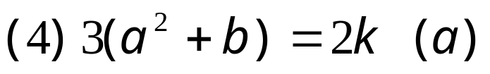
Questions 1
Transposition of Formulae (Change of Subject)
Make the indicated variable the subject of each formula:

Slide 7
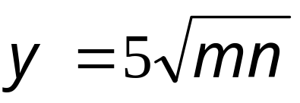

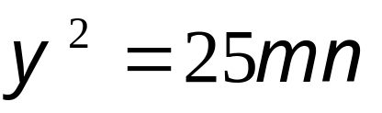
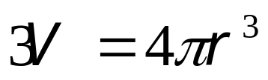
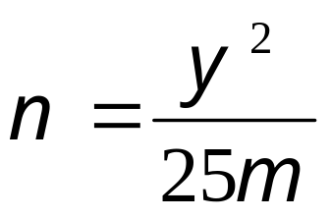
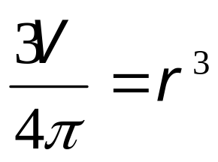

Examples 2
Transposition of Formulae (Change of Subject)
Example Question 5: Make n the subject of the formula:
Example Question 6: Make r the subject of the formula:
square both sides
multiply by 3
Divide by 25m
divide by 4π
Take cube root

Slide 8
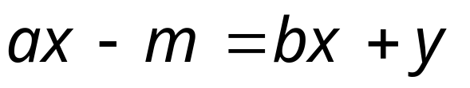
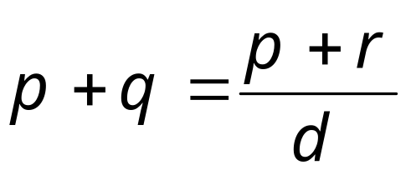
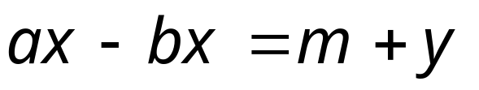
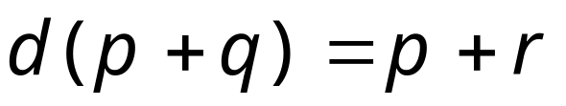
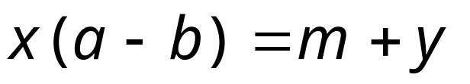
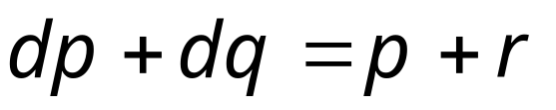
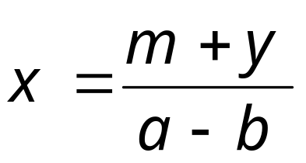
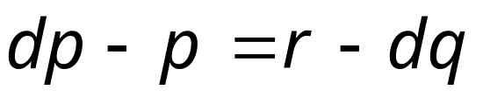
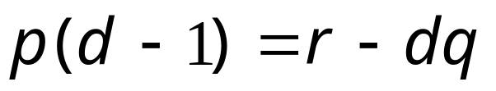
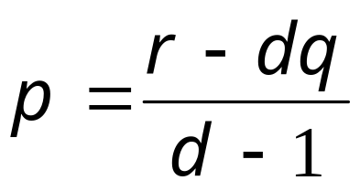
Transposition of Formulae (Change of Subject)
Example Question 7: Make x the subject of the formula:
Example Question 8: Make p the subject of the formula:

Slide 9
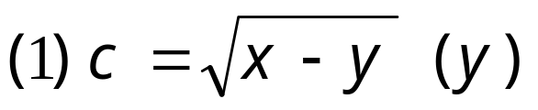
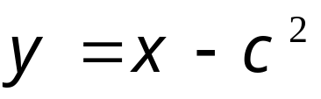
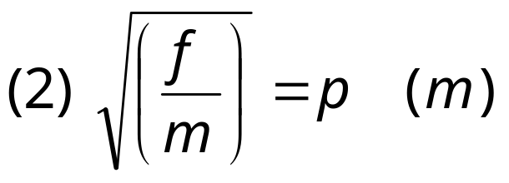
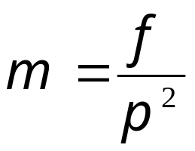
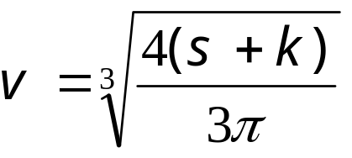
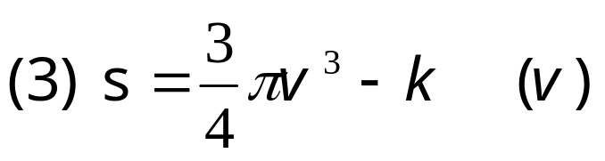
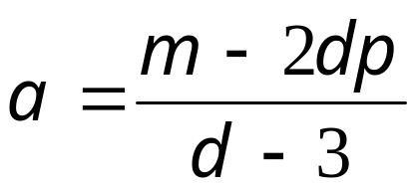
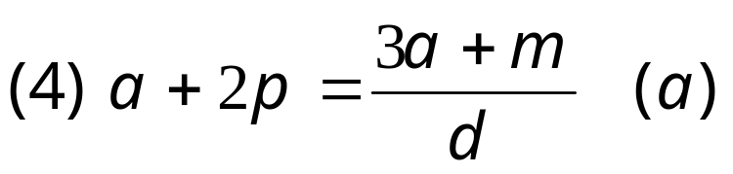
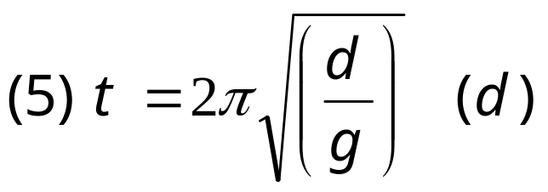
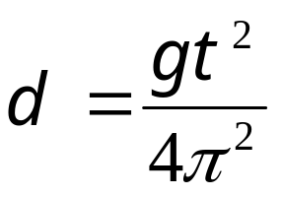
Questions 2
Transposition of Formulae (Change of Subject)
Make the indicated variable the subject of each formula:

Slide 10
worksheet
Questions 1
Questions 2

